Slide 1
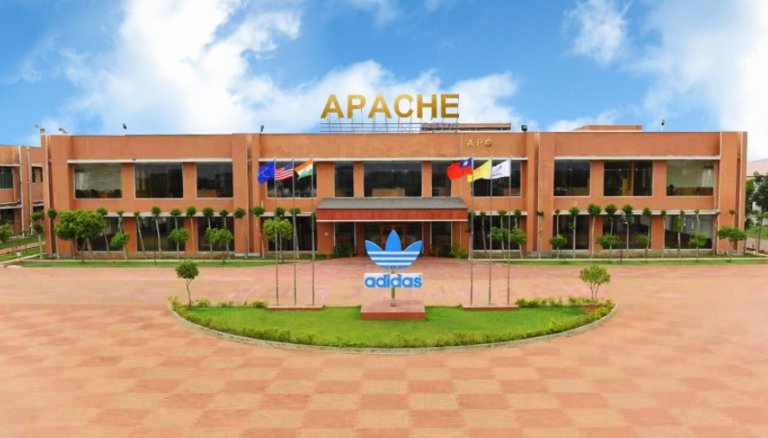



Apache Footwear India Private Limited
APACHE APC MES
Cutting Material Management
System
Report Presented
Presented by : Manohar-G ( APC-IT )
2025 September 24

Slide 2

🛠 Meeting Focus Areas
项目范围 Project Scope
1
项目范围 Project Scope
项目范围 Project Scope
项目规划 Project Schedule
项目规划 Project Schedule
2
项目规划 Project Schedule
项目团队Project Team
3
项目团队Project Team
项目团队Project Team
4
项目组织 Project Organization
项目组织 Project Organization
5
项目沟通-工具 Project Communication- Tools
6
项目沟通 Project Communication

Slide 3
项目范围 Project Scope
序号 No. | 类别 Category | 范围内 Scope-in | 范围外 Scope-out | 备注 Remark
1 | 系统系统System | 1. The Cutting Material Management System aims to enhance material tracking and availability across production lines. The system will enable monitoring of material status for each PO , helping to proactively identify and address potential shortages. By predicting material unstock situations, the solution will reduce line stoppages and improve overall production efficiency. Additionally, the system will be integrated with MES to trigger automatic email alerts for rescheduling, ensuring timely communication and smoother operational flow. | -
2 | 平台 Platform | MES (customized function) | MES
3 | 区域 Region | APC | -

Slide 4
项目规划 Project Schedule
09/19 PI
09/24 Kick-off
2026/01/08 Project sign-off
2026/01/10 Go-live
09/09
09/12
09/15
09/18
09/20
12/20
12/20
12/27
01/04
01/08
01/10
01/30
02/17
PI
09/19 Delay
09/24 KO & Blueprint Review
Close
完成
Delay
延迟
On-going
进行中
Not start
未开始
KO Prep
09/24 Ongoing
蓝图Blueprint
09/24 Ongoing
Realization ：2025/12/27 Not started
12/27 User training
Not started
GRR：2026/01/08
Not started
2026/01/10 Go-live
Not Started
Project Exit：2026/02/17
Not started
We are here

Slide 5
Project Team
Project Team
Project Manager
Supporting Team
Project Development Team
Manohar-G
IT
Planning
Purchase
Warehouse
Manohar-G
Chandrasekhar-v
Nagarjuna
Derek-yang
Balaji-v
Syamsundar-r
Rakhi

Slide 6
项目组织 Project Organization
Project Sponsors
IT
Steering Committee
Project Group Management Office (PMO)
Rakhi , Derek-yang , Balaji-v ,
Manohar-g
Project Director: Chandra (IT)
Project Manager-APC: Manohar-g (IT)
BPO: business process owner
Core Business Process Group
Planning Department
Purchase Department
Warehouse Department
APC IT
BPO : Nagarjuna,
KU : Rakhi
BPO : Derek-yang
KU : Derek-yang
BPO : Balaji-v
KU : Balaji-v
Team Leader : Syamsundar-r
Project Developers : Manohar-g

Slide 7
项目沟通 Project Communication
Type of Communication | Frequency | Purpose and Content | Output | Originator | Attendees / Senders
Weekly Report | Every Saturday till project go-live APC 16:00-16:30 | Email report on project progress | Project Progress Report | IT | IT Members
Weekly meeting – Project | Every Thursday till project go-live | Report on the progress of the project Next work plan Where help is needed | Meeting Minutes | IT | Planning , Warehouse , Purchase , IT , Production
项目沟通-工具 Project Communication- Tools
Email
WhatsApp

Slide 8
CMT 工作流程 CMT Work-flow
Data Capture
BOM
Provides base material requirements.
Cutting Material Report
Input purchase data
Issue materials, verify stock
Purchase Team
Warehouse Team
Track Purchase Status
Warehouse stock data
Production
Check assigned POs start cutting only if fully ready escalate
Ensure BOM is accurate
validate material need
resolve errors
Track PO-wise readiness
material issues
escalate to teams
Planning Team
Plant In-charge
Line Supervisor
shares
Assigns
Top
Management
Sees high-level overview
View overall readiness %
material trends
Top Management
Cutting Material Report auto-syncs BOM,PURCHASE, WAREHOUSE, PLANNING AND PO DATA| Triggers alerts and tracks material readiness

Slide 9

Cutting Material Availability – Line Supervisor
📆
From
2025/07/01
📆
TO
2025/07/05
PO NO
All
Status
Line
All
All
📋 Assigned Pos
5
✅ Ready to Cutting
3
❌ Not Ready
1
⚠ Escalated
1
PO Readiness List
Day | Line | PO NO | Article | Material Status
2025/07/05 | AP11CO5 | 1000042525 | Samba | ✅ OK
 |  | 1000042579 | Samba | ❌ Short
Check
Check
Material Checklist by PO
PO NO
By default the field takes short material status po in ascending order
1000042579
PO NO | Article | Material | Material Name | Required Qty | Available Qty | Shortage Qty | Status | Invoice | ETA
1000206709 | Samba | M001 | Material 1 | 125 | 125 | 0 | ✅ OK
1000206709 | Samba | M002 | Material 2 | 520 | 300 | 220 | ❌ Short | INV-MAT-20240620-0048 | 2025/07/05
Raise Escalations
PO NO
1000042579
Issue
Submit
Enter Issue
Request store verification
PO NO
Check
1000042579

Slide 10

Cutting Material Availability – Plant In-charge Dashboard
📆
From
2025/07/01
📆
TO
2025/07/05
All
Line
PO NO
Plant
All
All
Status
All
📋 Total POs Today
28
✅ Fully Ready Pos
19
🚫 Shortage Pos
7
🔁 Delayed Pos
2
PO-Wise Material Readiness Status
Date | PO NO | Model | Plant | Line | Material Readiness % | Status | Delay | Action
2025/07/02 | 1000042579 | SAMBA | AP11 | AP11C02 | 100% | ✅ Ready | - | Start Cutting
 | 1000042525 | STANSMITH | AP10 | AP10C04 | 75% | ❌ Short | 1 DAY | Escalate
 | 1000215486 | ULTIMATE | AP09 | AP09CO3 | 90% | ❌ Short
2025/07/03 | 1000042578 | SAMBA | AP11 | AP11C02 | 100% | ✅ Ready | - | Start Cutting
 | 1000042524 | STANSMITH | AP10 | AP10C04 | 100% | ✅ Ready | 1 DAY | Escalate
 | 1000215485 | ULTIMATE | AP09 | AP09CO3 | 90% | ❌ Short
Check
Material Name | Required Qty | Available Qty | Short Qty
Fabric A | 200m | 160m | 40m

Slide 11

Cutting Material Availability Dashboard – Top Management
Plant
Line
Submit
📆
From
2025/07/01
📆
TO
2025/07/03
All
All
📦 Material Readiness %
82% Ready
🚨 Open Escalations (issues not yet resolved)
5
📋 Total POs Today
36
📈 Avg Delay
2.1 days
Purpose: Compare different plants to see which ones are better prepared for cutting.
Description : Shows % of material availability across all assigned POs
Benefits : Identify which plant is performing well and where attention or escalation is needed.
Top 5 Short Materials :
Material | Short Quantity | Affected Pos
FTWR WHITE 01F7 54 | 340m | 3
1.4MM ECO SOFT MATTE | 220m | 8
CEMENT TWICE | 165m | 21
WHITE LATEX | 100m | 4
ST-A990-06E EPM5 MESH | 92m | 1
Purpose: Highlight the most frequently short or unavailable materials, across all POs.
Benefits : Quickly identify which raw materials are causing the biggest disruptions—helps guide procurement priorities
Date | No Of Pos | Material OK Pos | Material Not OK Pos | Material Readiness % | Status
2025/07/01 | 120 | 120 | 0 | 100% | ✅ Ready
2025/07/02 | 154 | 150 | 4 | 97% | ❌ Short
2025/07/02 | 182 | 140 | 42 | 75% | ❌ Short

Slide 12




